Slide 1
Chemistry – Jan 6, 2020
P3 Challenge-
Determine the number of a) protons, b) neutrons and c) electrons present in an atom of Copper – 65. Then state the d) atomic number and the e) mass number.
Objective –
Atomic Structure
Get out your colored periodic table. You will need it today. New ones are available if you need.

Slide 2
Chemistry – Jan 6, 2020
Objective –Atomic Structure / Bohr Model
Assignment: Bohr Model Worksheet
Agenda
Atomic Structure overview
Bohr Model
Valence and Core electrons

Slide 3
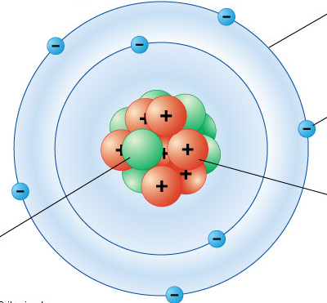
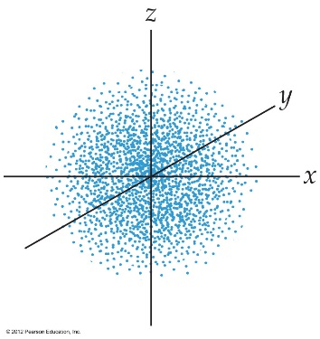
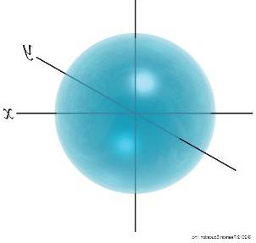
Review Atomic models
Recall the Nuclear model and where subatomic particles are located
Recall the Bohr model that uses quantized orbits
Recall Quantum Mechanics that uses quantized orbitals
Orbitals that we draw represent a 95% probability of finding an electron in that space.
Any single orbital can contain up to two electrons (0, 1, or 2)

Slide 4
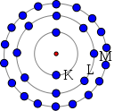
Bohr Model
Based on x ray spectra line data
Electrons located in nested shells located in specific quantized orbits
Shells given labels from Xray spectra: K, L, M, N.
Each shell can hold only a given number of electrons:
K – 2 electrons
L – 8 electrons
M – 8 /18 electrons (up to Ca it’s 8)
N – 18 / 32 electrons (up to Sr it’s 18)
The build an atom app used an unlabeled Bohr model.

Slide 5
Example
Draw the Bohr model for the most abundant isotope of Phosphorus.
Z = From Periodic Table
Gives #p and #e for neutral atom.
Find most abundant isotope mass number, A = on list of abundances.
Determine #n. A – Z
Draw a nucleus for the neutrons and protons. Label.
Draw a circle around the nucleus for K. Place up to 2 electrons on this orbit.
Draw a circle around K for L. Place up to 8 electrons on this orbit.
Continue with M and/or N with 18, and 32 electrons, until all electrons used.

Slide 6
Valence Electrons / Core Electrons
Valence electrons located in the shell with the highest energy level. All other electrons are core electrons.
#Valence electrons varies from 1 to 8 with a completed octet most stable
Ex: Mg Highest Energy = 3 2 valence electrons
Ex: C Highest Energy = 2 4 valence electrons
Number of valence electrons will always match the group A number.
Atoms with the same number of valence electrons, that is, elements in the same A group, will have similar reactivity.

Slide 7
Periods
1-7 Rows
Groups
Columns
1-18
1-8 A / B
A = main group elements
Alkali metals
Alkaline earth metals
Transition metals
Other metals
Semimetals
Halogens
Noble gases
Other Nonmetals
Lanthanides
Actinides
Division line
1A
2A
3A
4A
5A
6A
7A
8A
1
2
3
3B
4B
5B
6B
7B
8B
8B
8B
1B
2B
4
5
6
7

Slide 8
Exit Slip - Homework
Exit Slip: Draw the Bohr Model for Oxygen-16. State the number of valence.
What’s Due? (Pending assignments to complete.)
Bohr Model Worksheet
What’s Next? (How to prepare for the next day)
Read Holt p84 - 88

